Slide 1
Sophia’s “Wonder Eph” Cape
a Williams Cape to show off your eph Pride!
Great for all ages, Interactive, and perfect for school spirit
Materials:
4 additional red LEDs
1 yard of purple felt or flannel
Or more?
Inputs and Outputs
Input – switch
Input - button
Output – 6 red LEDs
Output - buzzer
W

Slide 2

Sophia’s Interactive Pirate Ship
A pirate ship with cannon that lights up and buzzes!
Perfect for kids and for interactive Decoration
Materials:
White puffy paint
Inputs and Outputs
Input – button
Input - switch
Output – red LED
Output - buzzer
Mermaid’s Wrath

Slide 3

Sophia’s Peter Pan Play Pad
An interactive play pad and wall art that Rings and Shines!
Great for kids to interact with and also a magical decoration
Materials:
Black felt for background
At least ~ 5.5 in x 6 in
Blue and brown felt
Muslin fabric
Conductive thread patches
Black, brown, blue, and yellow thread
At least 3 yellow or white Lilypad LEDs
1 sewable battery holder
Conductive thread
Scissors
Needles
1 coin cell battery
1 sewable battery holder
1 light sensor
Lilypad speaker
Make tinkerbell things with French knots, different functions of light
Inputs and Outputs
Input – conductive thread patch button
Input - light sensor
Output – speaker (to be tested)
Output – Lilypad LEDs
Button pics to correspond with
Color of light
speaker
The Second Star to the Right
light sensor
This project has multiple components. A light sensor will be used to make the moon glow and the stars fade brightness through LEDs. Users can also interact with the clock hands so that when they touch the “bell” rings 12 times. I will use hidden stitch for most of the work but back stitch for the words.
Battery holder

Slide 4

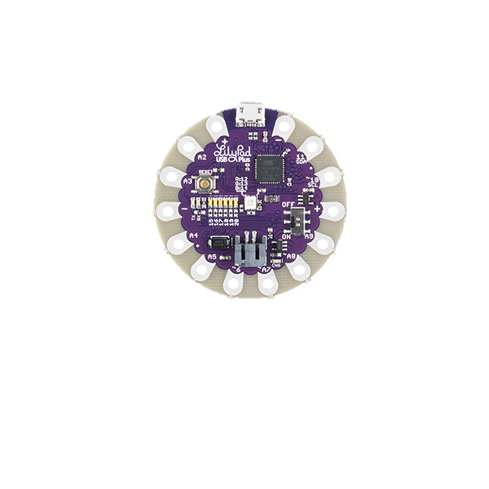

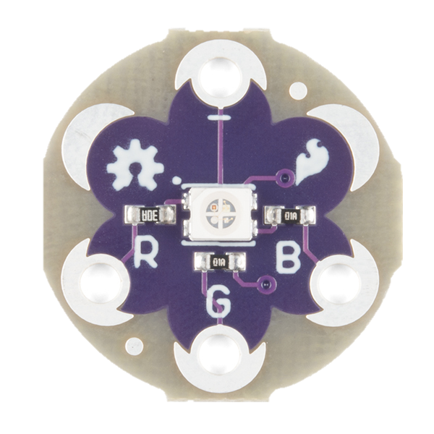







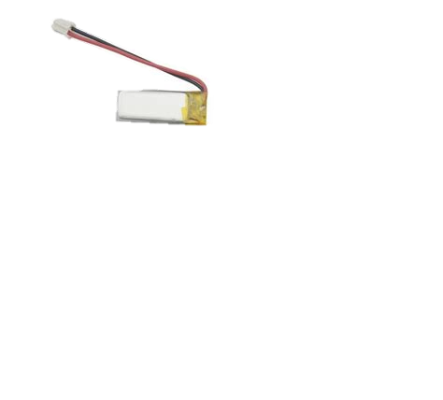



























Peter Pan Play Pad Circuit Diagram by Sophia Clement An interactive tapestry with a ringing big ben, a light-up neverland star, and tinkerbell hiding in the dark
Notes:
Separate inputs from outputs, 3 per pin

Slide 5


























